Slide 1

Enhancing Data Analysis & Data Visualization Using Java.
A Study of CSV File Analysis Using Line and Bar Charts with MS Word Integration

Slide 2
DATA VISUALIZATION
Visual representation of data or information using some common graphics.
Data is visualized in the form of a chart, infographic, diagram or map.
The main goal of data visualization is to communicate data or information clearly and effectively to readers.
These visual displays of information communicate complex data relationships and data-driven insights in a way that is easy to understand

Slide 3
Common Visualization Technique:
Line charts
Stacked Bar graph
Tables
Pie charts
Histograms
Scatter plots
Heat maps
Tree maps

Slide 4
IMPORTANTANCE OF DATA VISUALIZATION
The importance of data visualization is that it helps people see, interact with, and better understand data.
A good visualization tells a story, removing the noise from data and highlighting useful information.
As the “age of Big Data” kicks into high gear, visualization is an increasingly key tool to make sense of the trillions of rows of data generated every day. Data visualization helps to tell stories by curating data into a form easier to understand, highlighting the trends and outliers.

Slide 5
Why Java?

Slide 6
Exploring the Functionality of Our Project
The program has a user interface that allows the user to browse and upload a CSV file.
After that, java program generates line and bar charts from a CSV file using the JFreeChart Library.
User will analyse the graph reading the graphs.
At last, we have a conclusion window to write the conclusion after ananlyzing different graphs.
Here we can write our conclusion and save it as a word file.

Slide 7
Methodology
1. AWT (Abstract Window Toolkit) and Swing libraries were used in project for creating graphical user interfaces (GUIs). Both libraries provided a set of classes and components for creating windows, buttons, menus, text fields, labels, and other graphical elements.
2. To generate a line chart in Java we used JFreeChart, firstly we created a dataset that contains the data to be plotted. This dataset can be created using various sources such as a database or a file(we used cvs file). Once you have the dataset, you can create a JFreeChart object and add a plot to it. For a line chart, we typically used an XYPlot.

Slide 8
3. We used org.apache.commons.csv.CSVFormat library in Java which supported function for reading and writing CSV (Comma-Separated Value) files.
4. We used org.apache.poi.xwpf.usermodel.* library in Java in part of the Apache POI project, which providesdsupport for reading and writing Microsoft Office files. And saving it in the document formate.

Slide 9
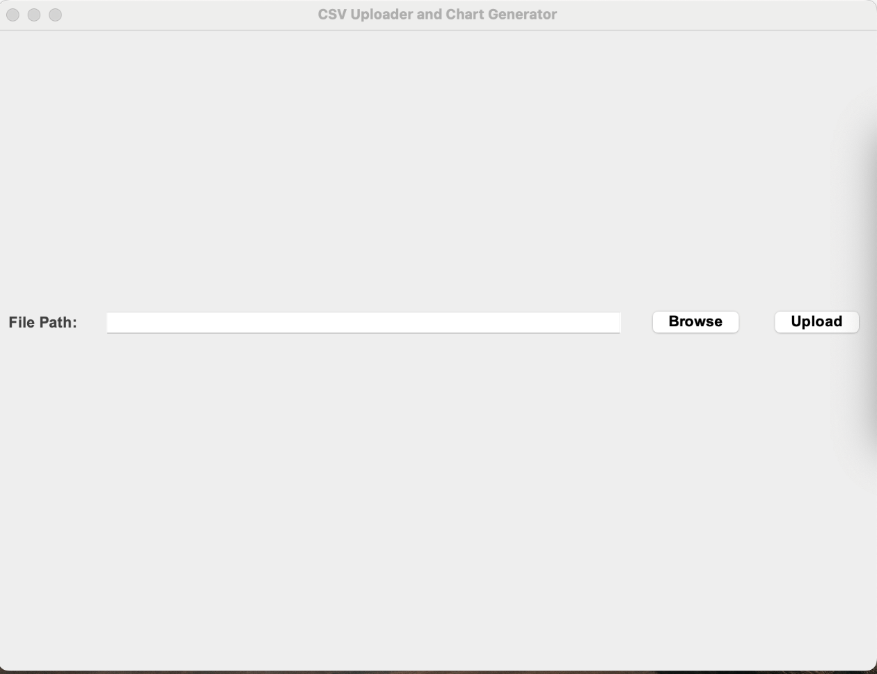
RESULT

Slide 10
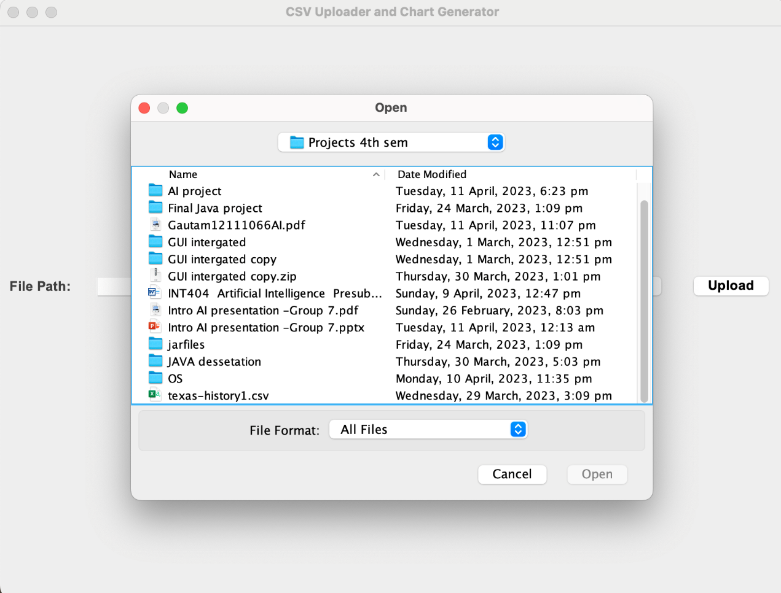
BROWSE FILE FROM YOUR DEVICE
BROWSE FILE FROM YOUR DEVICE

Slide 11
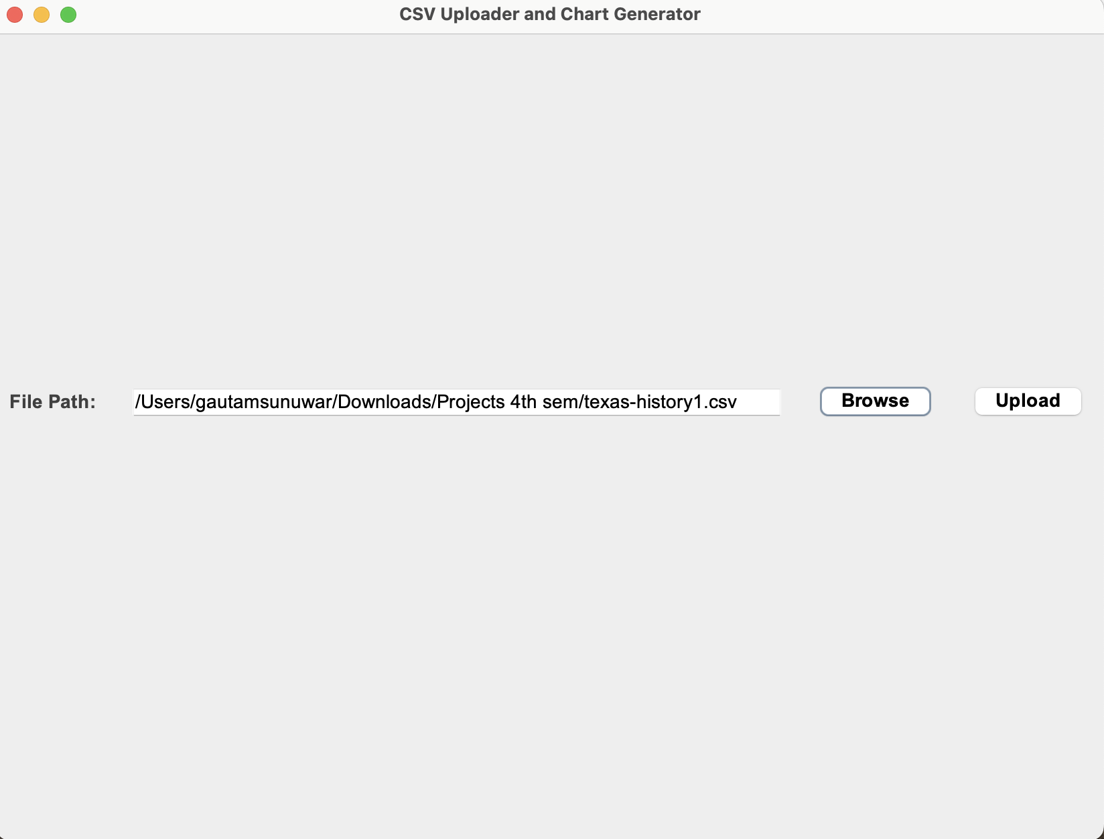
UPLOAD FILE FROM YOUR DEVICE
BROWSE FILE FROM YOUR DEVICE

Slide 12
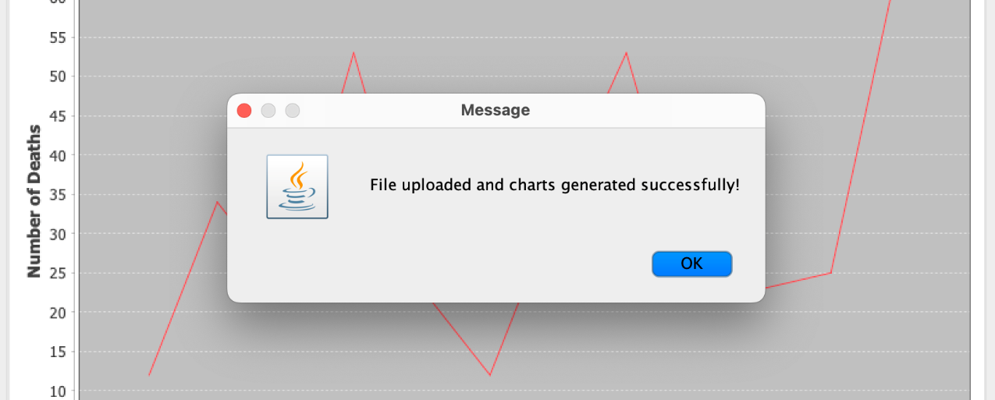
FILE UPLOADED
BROWSE FILE FROM YOUR DEVICE

Slide 13
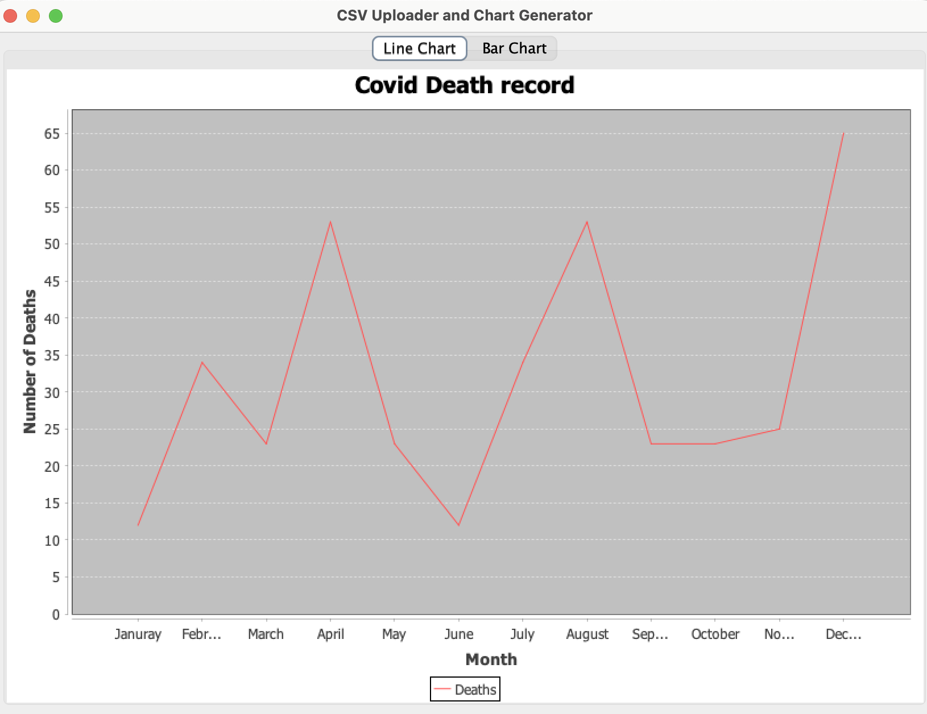
LINE GRAPH GENERATION

Slide 14
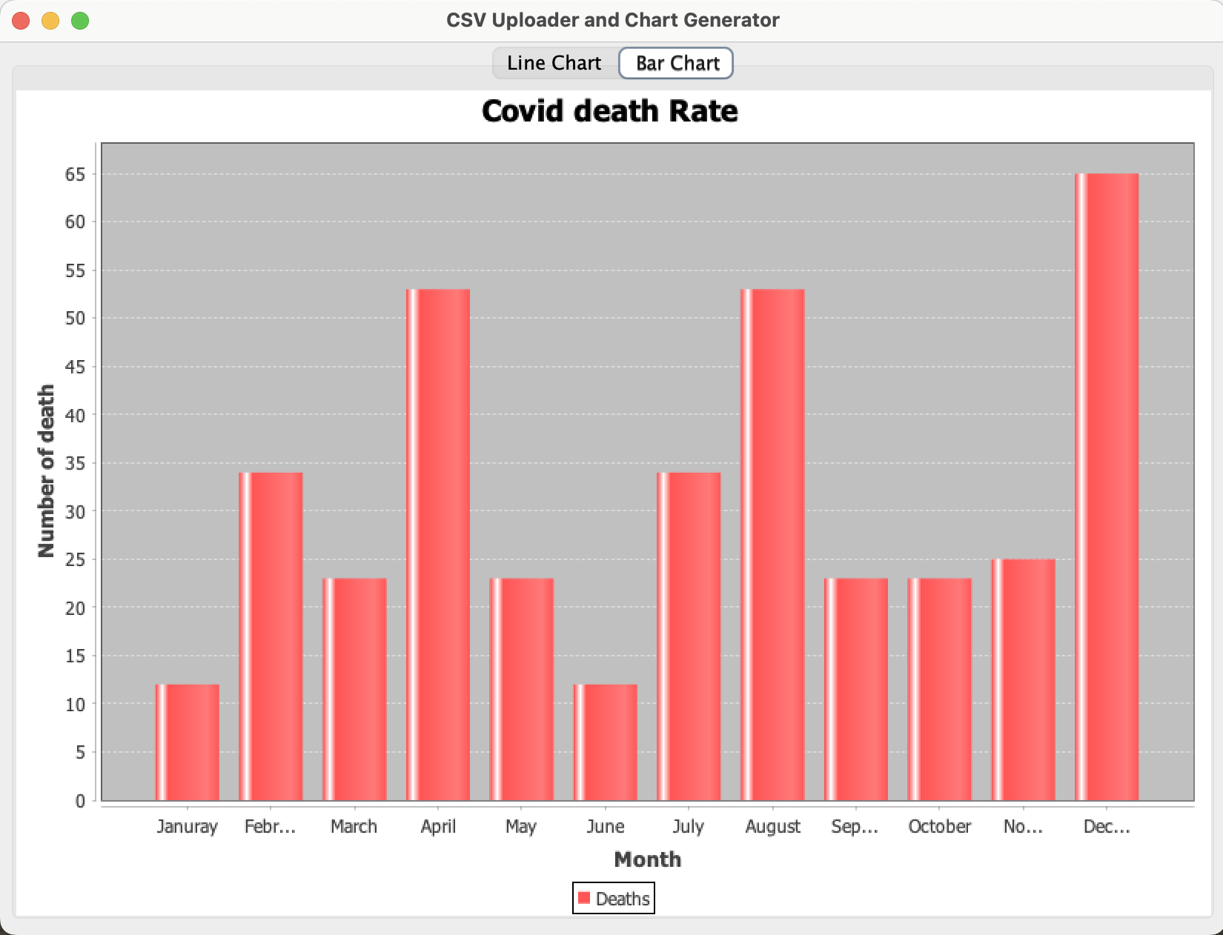

Slide 15
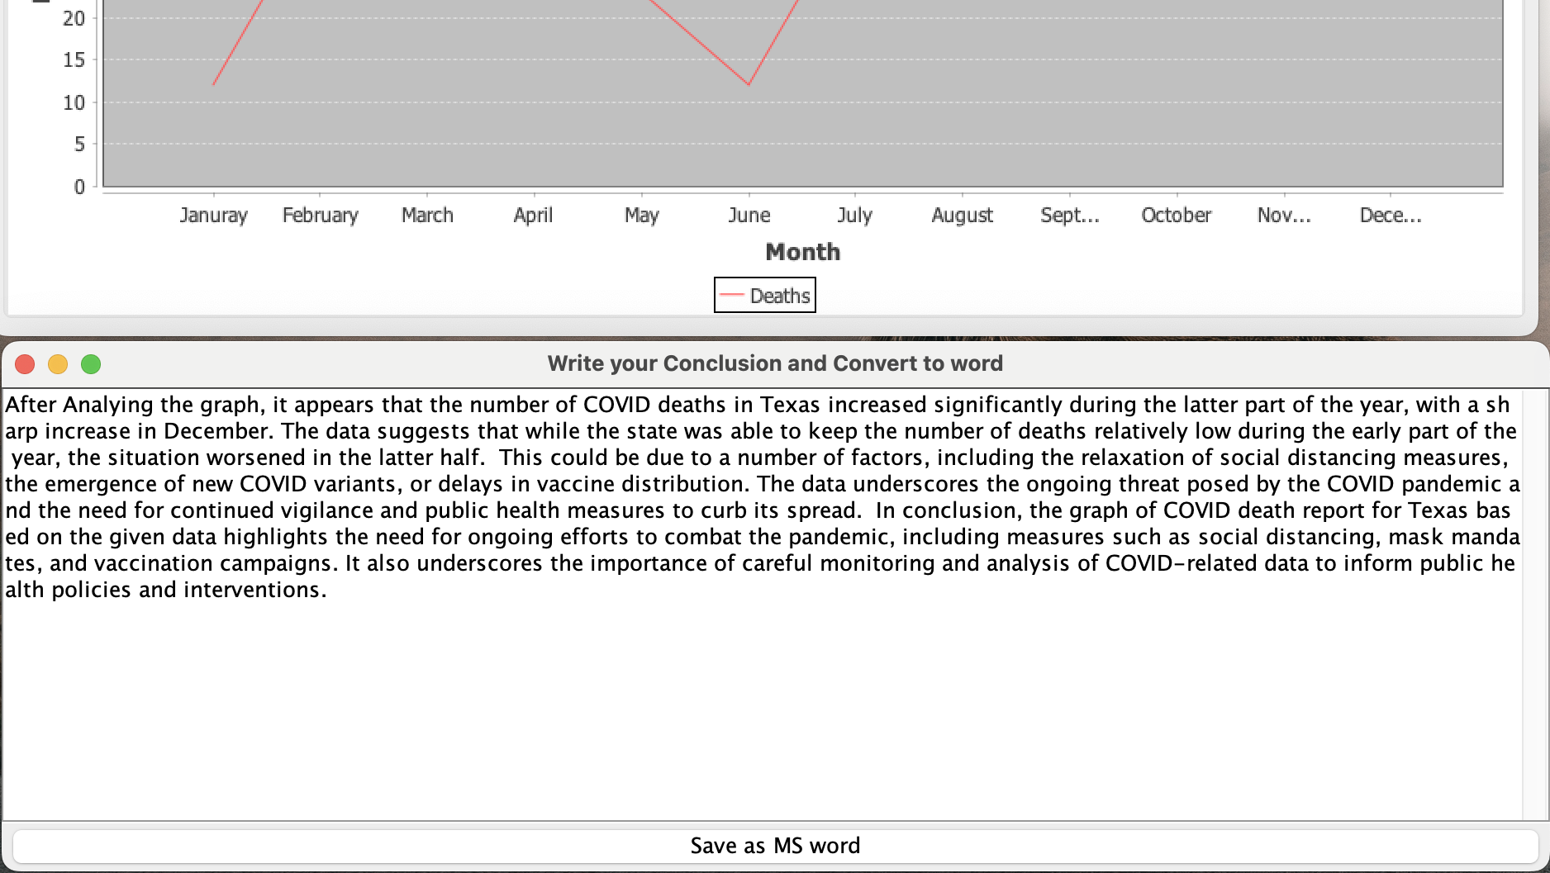
Write Your Conclusion here

Slide 16
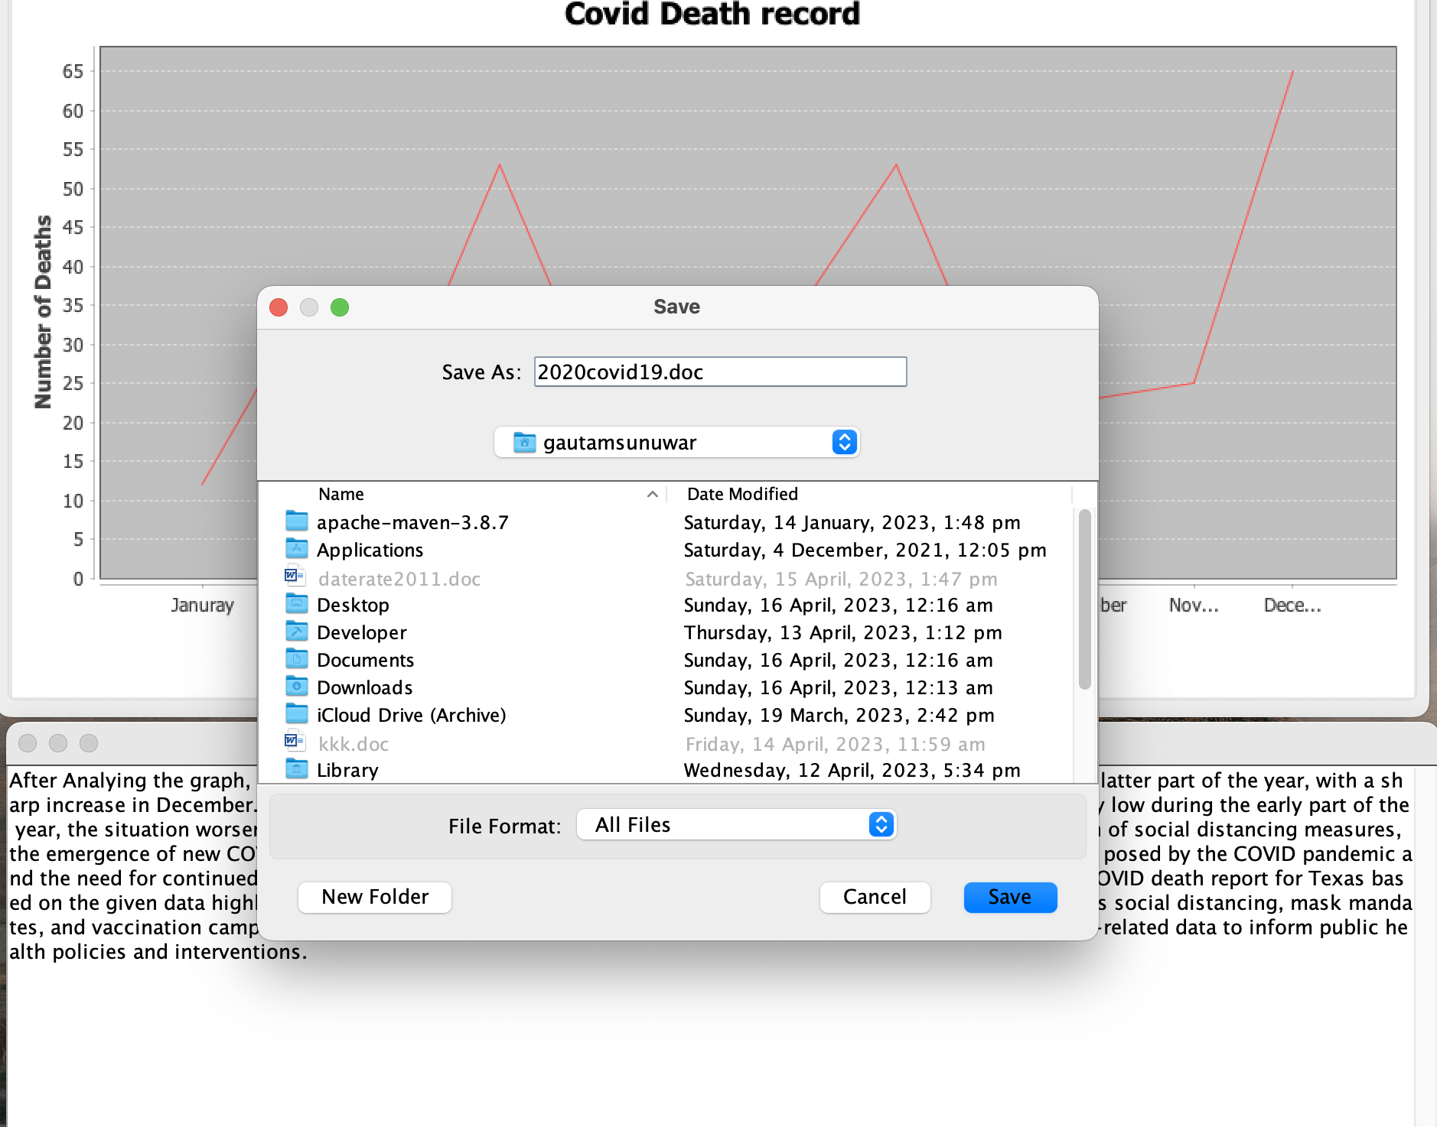
File Saving Path

Slide 17
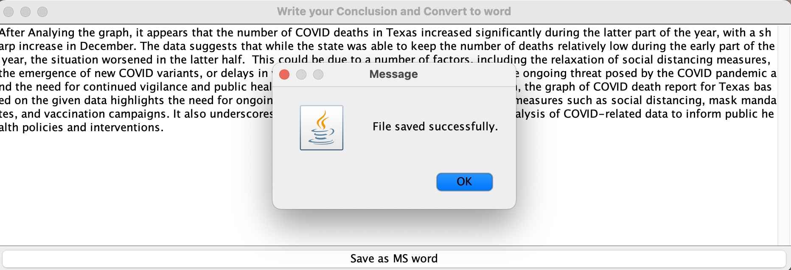
File Save

Slide 18
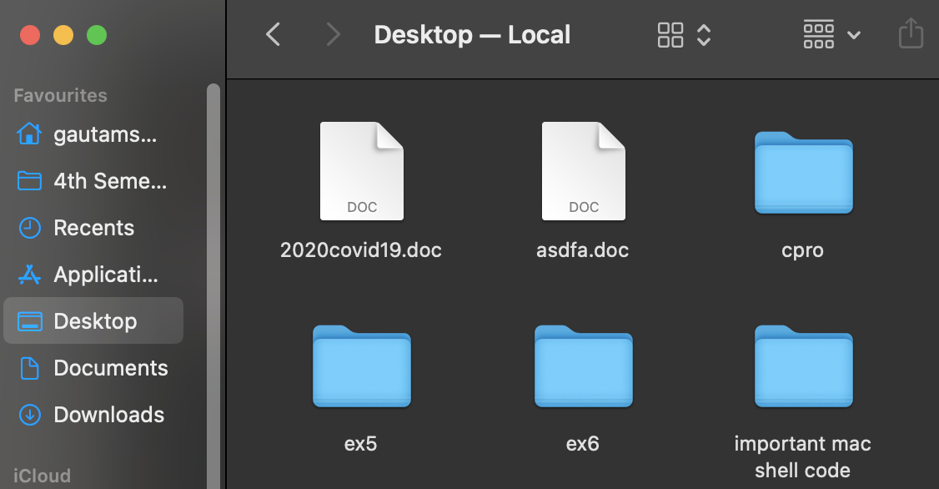
Conclusion File Saved

Slide 19
Limitations of our project on Data Visualization
1. The software is limited to generating only bar graphs and line graphs. It cannot generate other types of graphs or charts. .
2. Users are responsible for analyzing the generated bar graphs and line graphs by themselves and writing conclusions based on the data.
3. The software can only analyze one CSV file at a time. It does not have the capability to analyze multiple files simultaneously.
It is important to note these limitations in the software as they may affect the user's expectations and experience. Additionally, acknowledging these limitations can help guide future development and improvements

Slide 20
Analyzing the Distinctions between Our Project and Existing Tools.
PROPERTIES | MY PROJECT | EXCITING PROJECTS (Power BI and Tableau)
Platform and Technology: | Our project is built using Java and JFreeChart, which are open-source technologies | Power BI is a data visualization tool developed by Microsoft.I
Visualization and Interactivity | It generates only line graph and bar graph and the conclusion after analysis has to be written manually. | It provides wide range of functionalities including pie chart,scatter plots etc.
Customization and Flexibility | Jfree chart provides a high level of customization such as labels, colours, font to suit your specific needs | Power BI and Tableau also offer have some limitations due to their predefined templates and styles.
Data Transformation and Modeling | Our project may require additional coding and customization to achieve similar data transformation and modeling capabilities. | Power BI offers robust data transformation allowing users to clean, filter, and transform data before visualizing it.

Slide 21
FUTURE SCOPE
1. Expand the software to support multiple data formats, such as Excel files or JSON files, to increase the flexibility of data analysis.
2. Develop additional types of graphs or charts to provide users with more options for visualizing data, such as pie charts, scatterplots, and histograms.
3. Incorporate more advanced data analysis techniques, such as regression analysis, clustering, or time series analysis, to provide users with more in-depth insights.
4. Allow users to create custom graph templates with predefined layouts, colors, and fonts to provide more flexibility in graph creation.
5. Develop interactive features, such as zooming, panning, and hover-over tool-tips, to enable users to explore data in more detail.

Slide 22
6. Enable collaboration features, such as sharing and commenting, to allow multiple users to analyze and discuss data together.
7. Integrate machine learning algorithms to provide automated insights and recommendations based on the analyzed data.
8. Implement real-time data visualization capabilities to enable users to monitor data streams as they change in real-time.
9. Develop a mobile app version of the software to enable users to access and analyze data from their mobile devices.
10. Add a reporting feature that enables users to generate and export reports in various formats, such as PDF, HTML, or CSV, to share insights with stakeholders.

Slide 23
CONCLUSION
In conclusion, our project utilizing Java and JFreeChart has successfully achieved its objective of converting CSV file data into interactive line graphs and bar graphs.
The project offers a user-friendly interface that allows users to easily upload CSV files, select the data to be visualized, and generate vi
Overall, our project serves as a powerful tool for data visualization, empowering users to gain meaningful insights from CSV file data through visually compelling line graphs and bar graphs.
With further enhancements and optimizations, it has the potential to become a valuable asset for organizations and individuals seeking efficient data visualization solutions.sually appealing line graphs and bar graphs.

